Slide 1


Universidad de Valladolid
E.T.S. Ingenieros de Telecomunicación
Statistical analysis of noise in MRI:
Noise modeling
Santiago Aja-Fernández,
Laboratorio de Procesado de Imagen. Universidad de Valladolid (Spain)
www.lpi.tel.uva.es sanaja@tel.uva.es
OCTOBER 2016

Slide 2
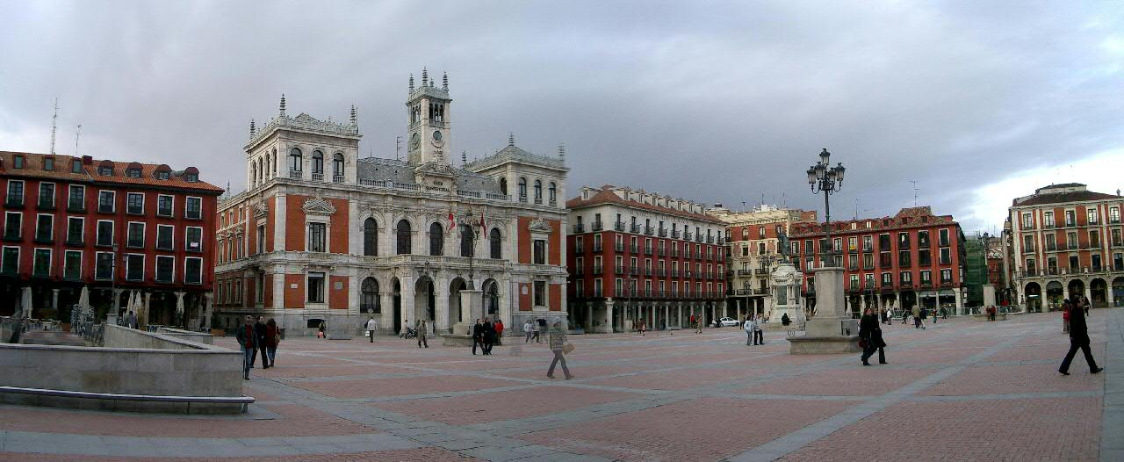
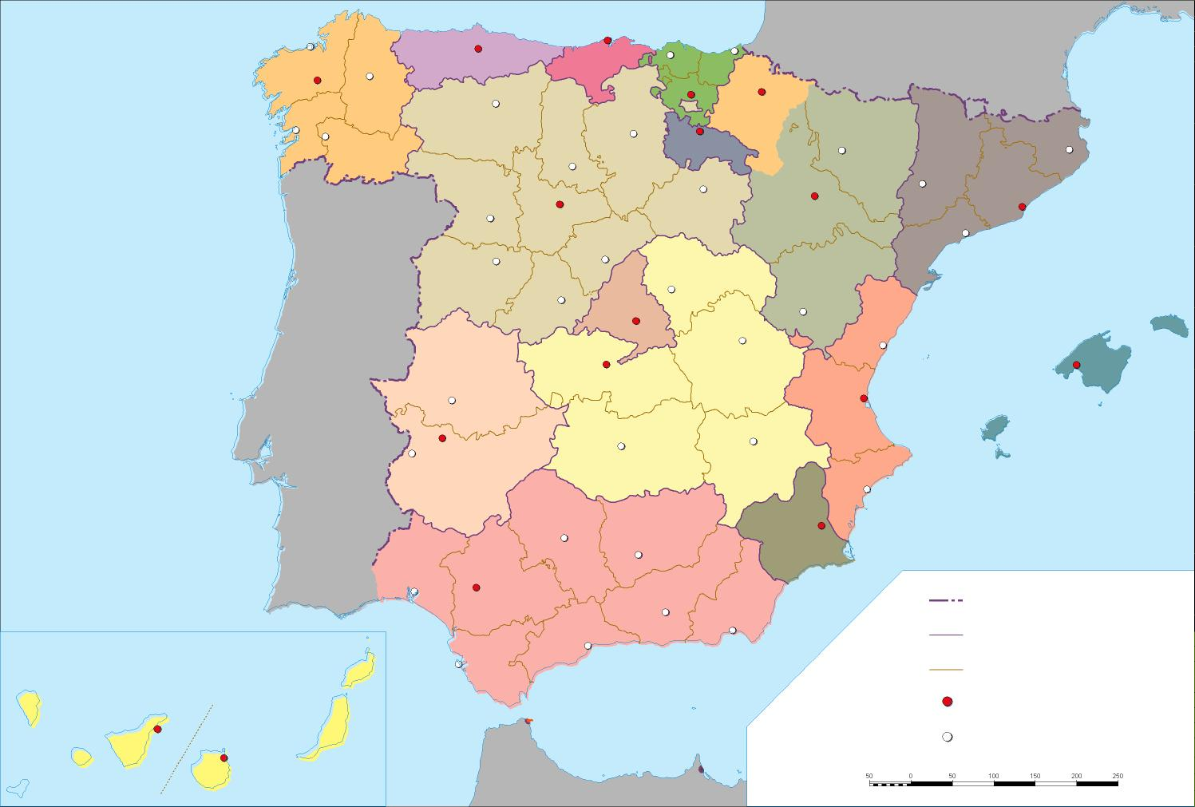
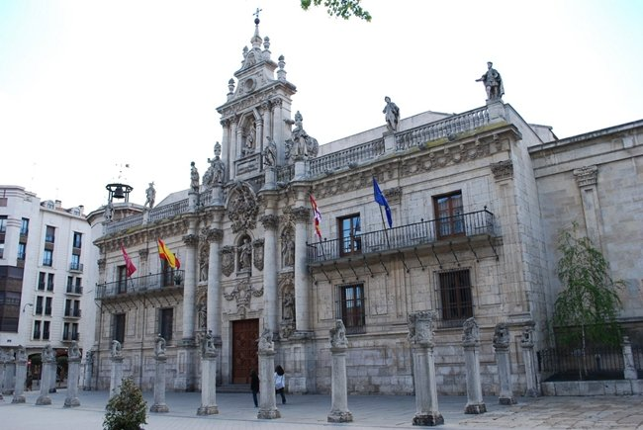

2

Slide 3
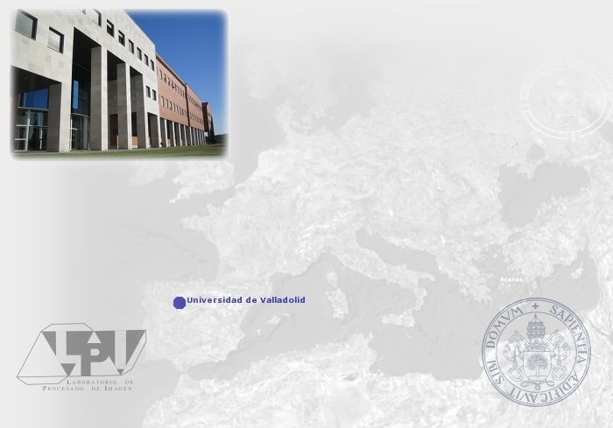
Image Processing
Lab
Noise models
Funded in 1997, the LPI is an officially recognized research group by the UVa since 2005
Its main activity falls mainly in medical image analysis and biomedical signal processing
It has captured funds by a total amount of more than 1,5 M€ from sources including several regional, national and European grant numbers
It is currently constituted by 17 people, including 6 professors and 7 PhD students
www.lpi.tel.uva.es
3

Slide 4
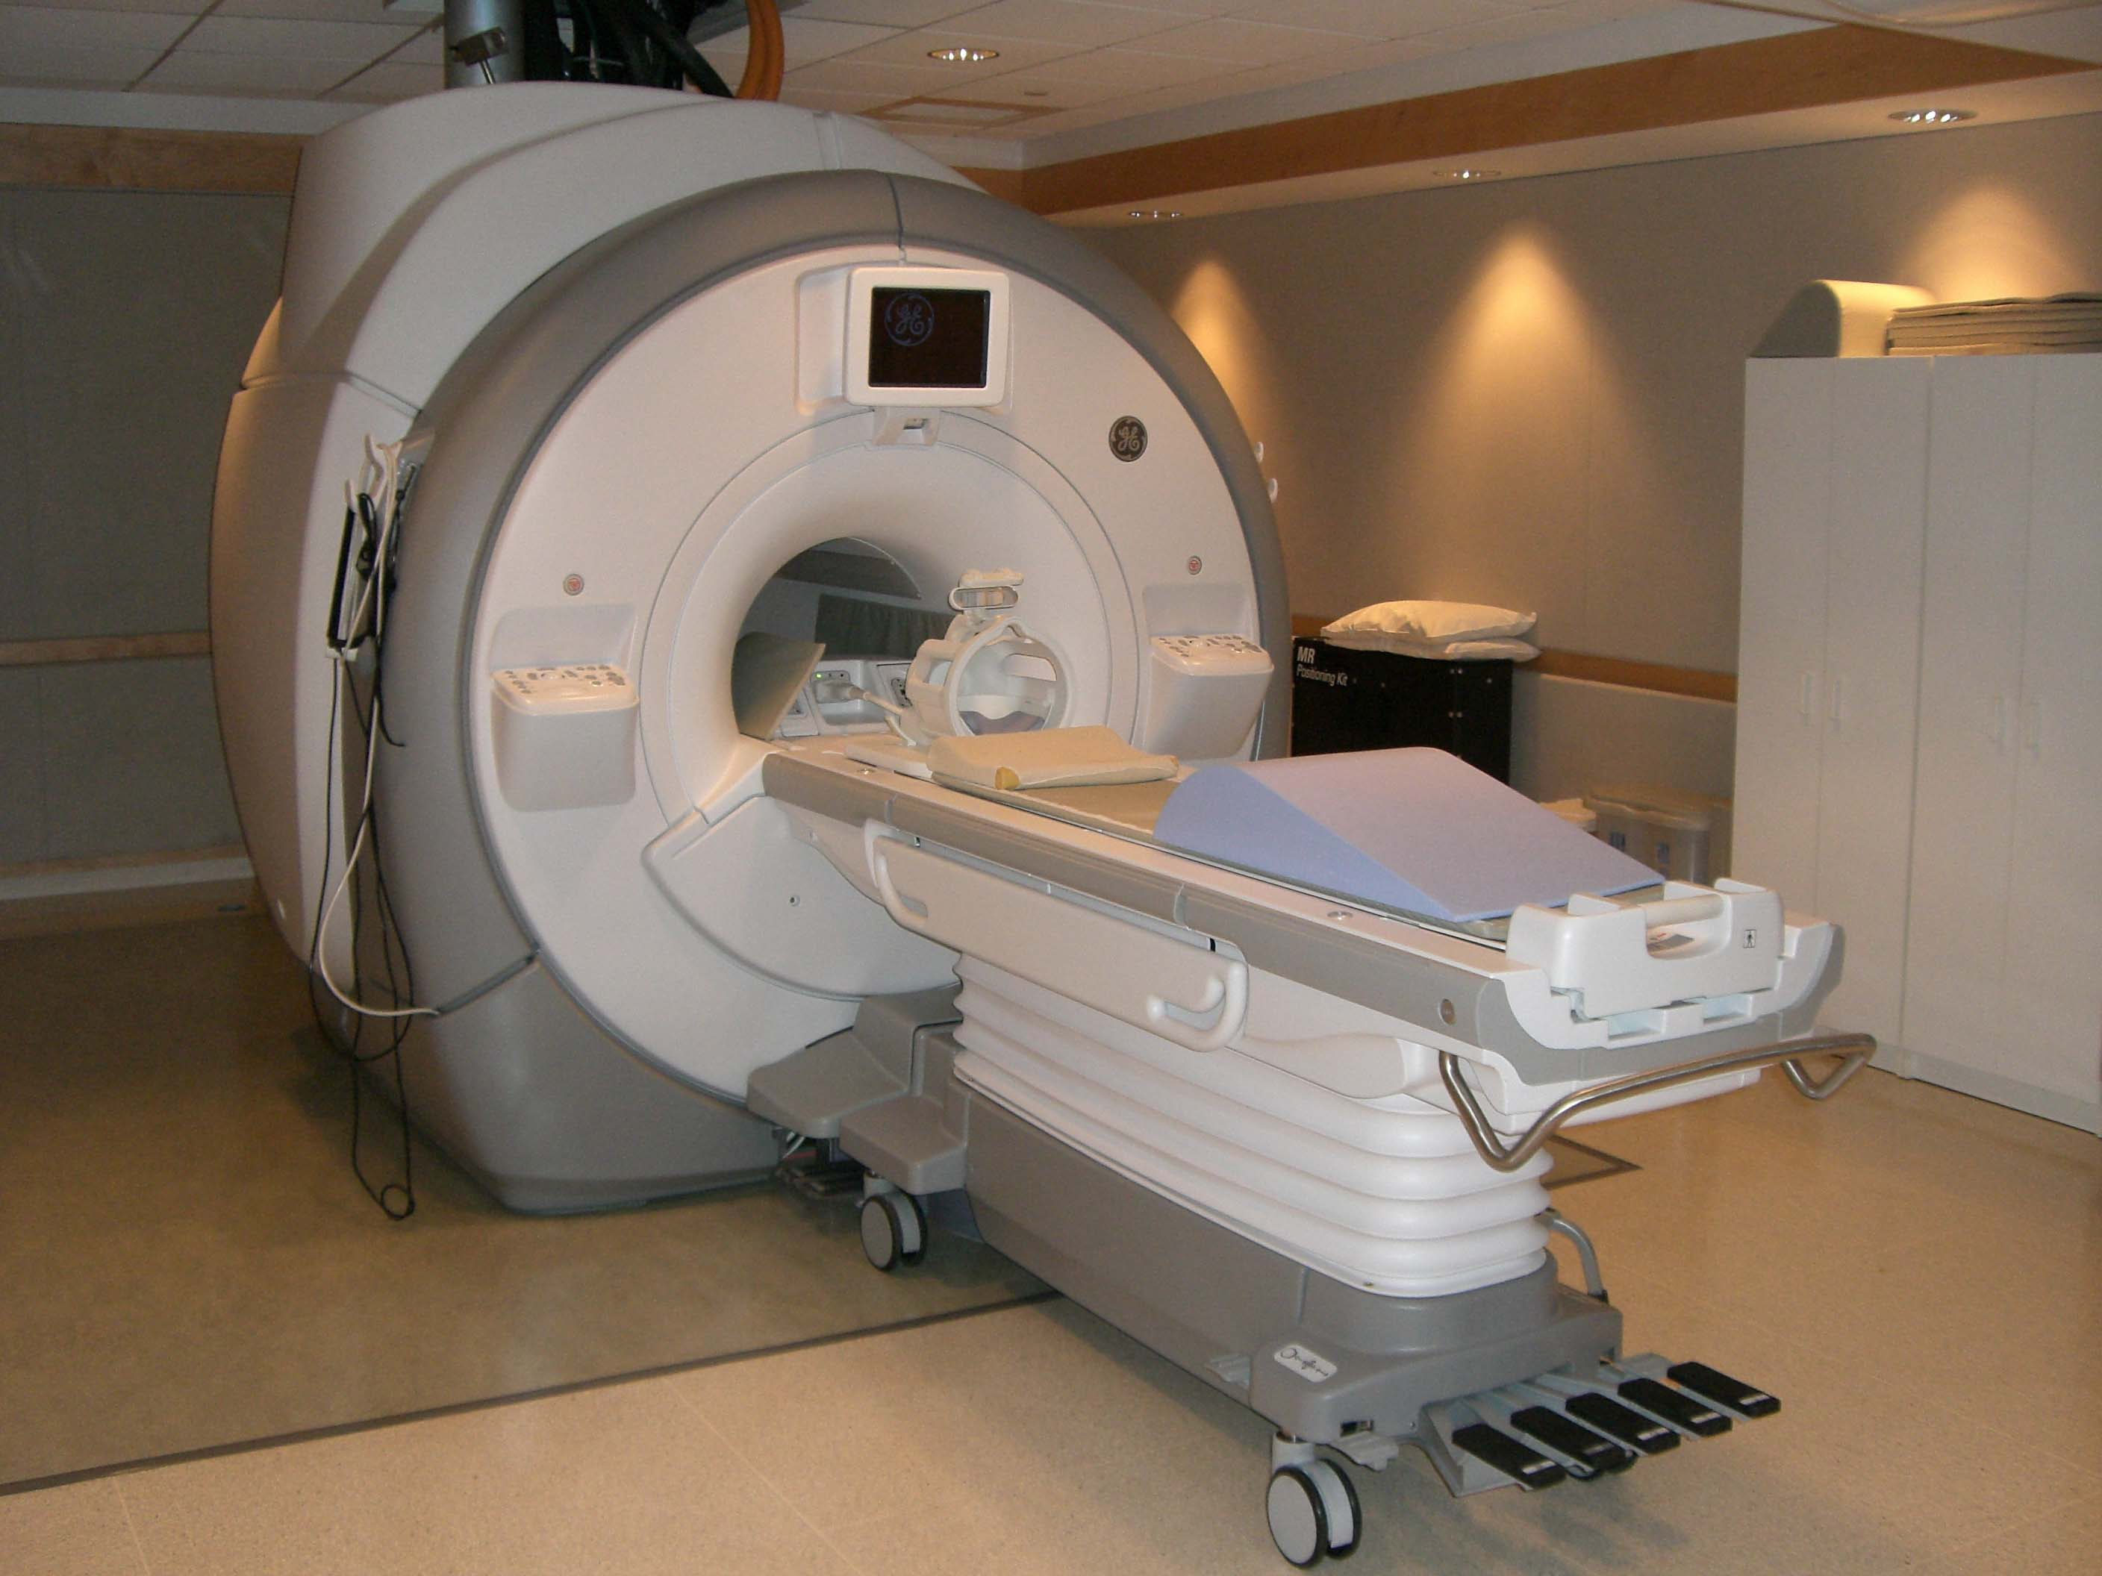
Parallel Imaging
Noise in MRI
4
Noise in MRI

Slide 5
Noise models
QUESTION: Are MRI data noisy?
5

Slide 6
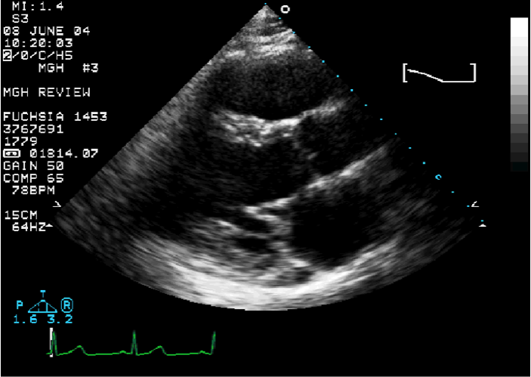
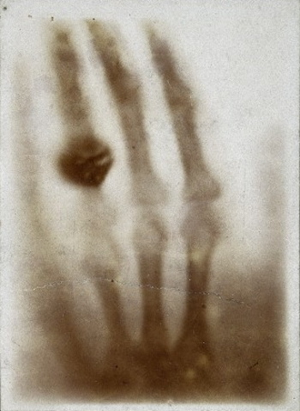
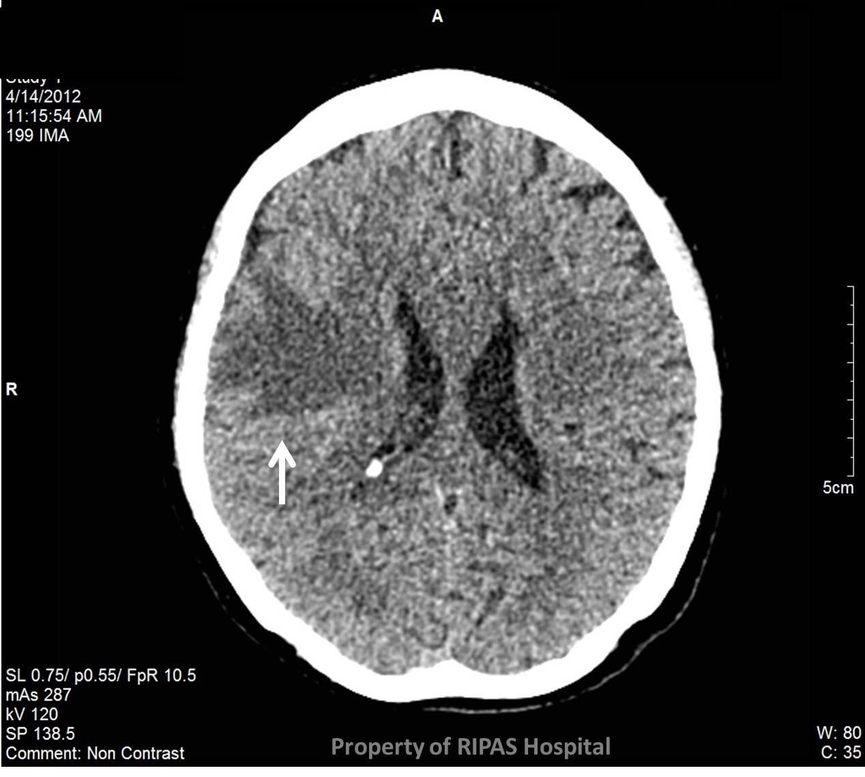
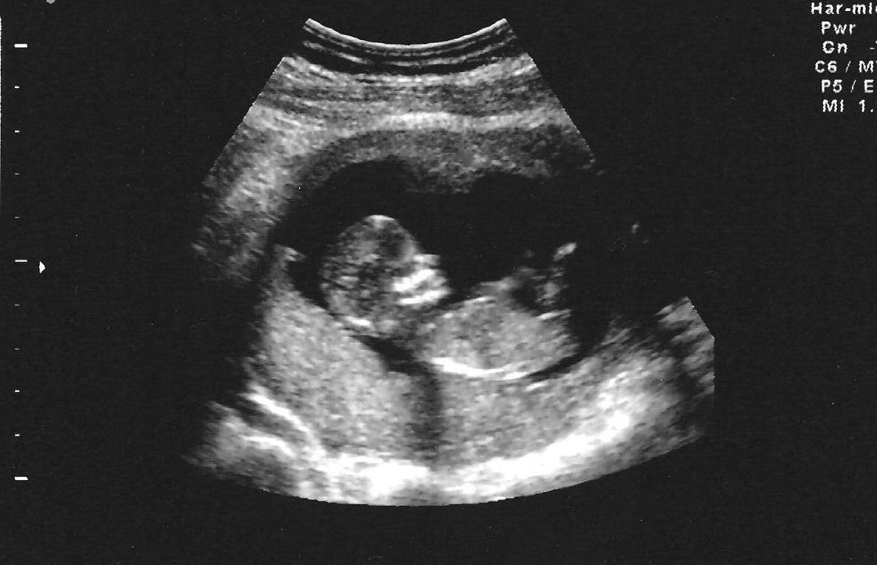
Noise models
6

Slide 7
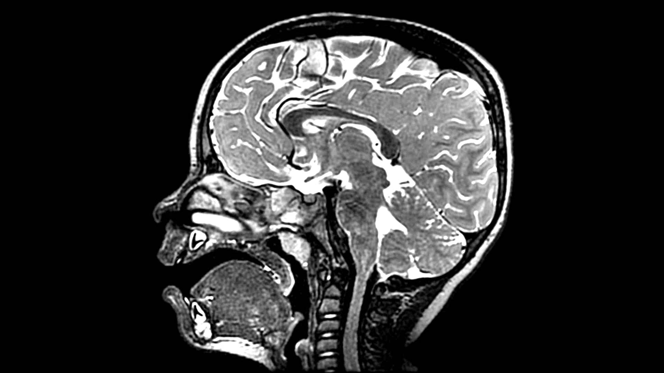
Noise models
7

Slide 8
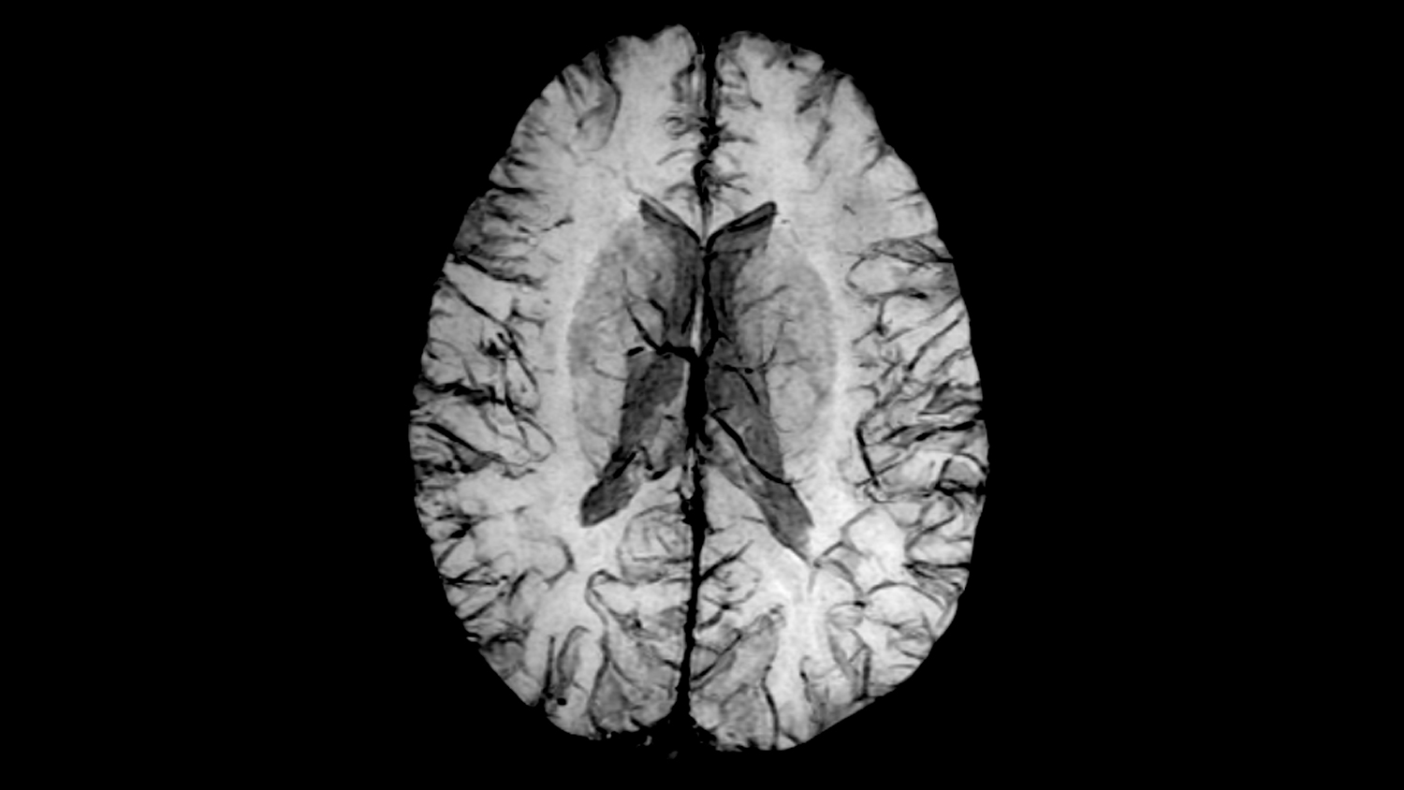
Noise models
8

Slide 9
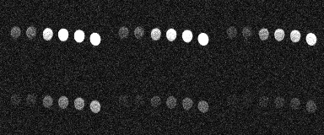
Noise models
Diffusion phantom for ADC estimation, different b values
9

Slide 10
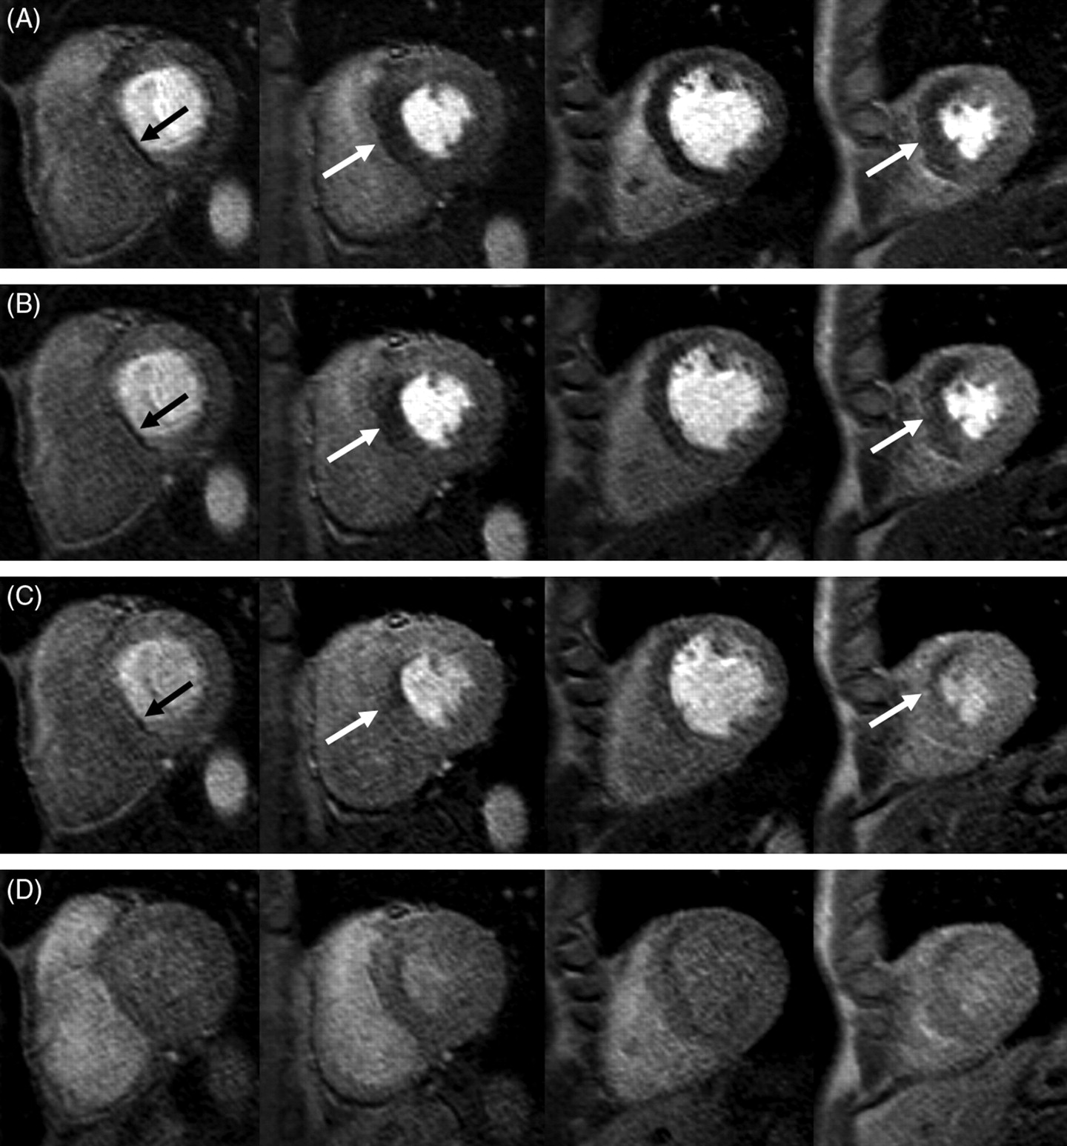
Noise models
Perfusion imaging sequence in the heart
10

Slide 11
Noise models
Noise in MRI
Affects visual quality of images
It may interfere with processing techniques
Accurate modeling of signal and noise underlies tools for processing and interpretation (MRI).
11

Slide 12
Noise models
Motivation: Why a statistical model?
Noise estimation
Filtering techniques: Conventional approach, LMMSE filter, Maximum likelihood…
Parameter estimation
Model based segmentation
In DWI: Diffusion tensor estimation (the model assures the good estimation)
12

Slide 13
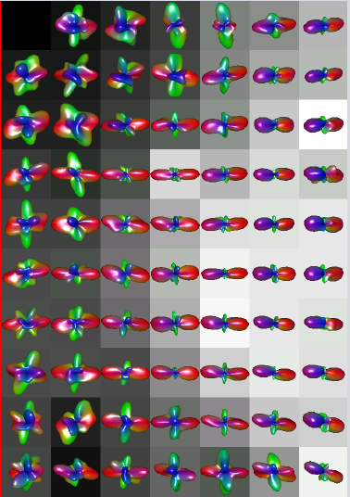
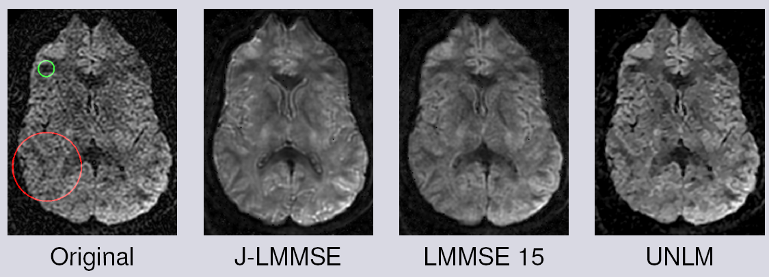
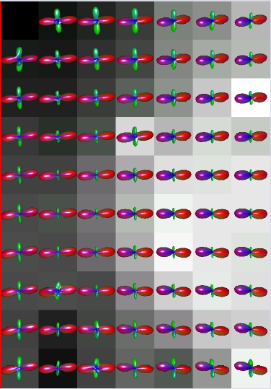
Noise models
13

Slide 14
Noise models
Outline
Complex model for each coil
Single coil acquisition
Multiple coil
Simplified models
pMRI: SENSE and GRAPPA
14

Slide 15
1- Complex model for each coil

Slide 16
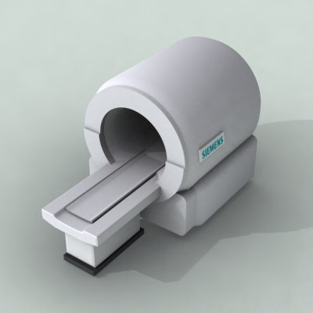
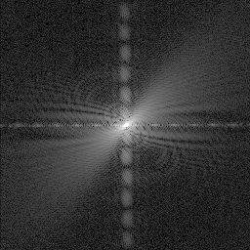
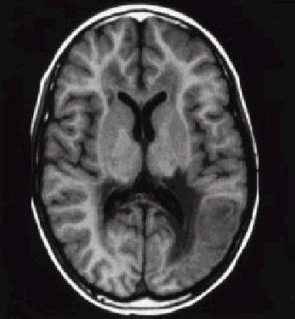
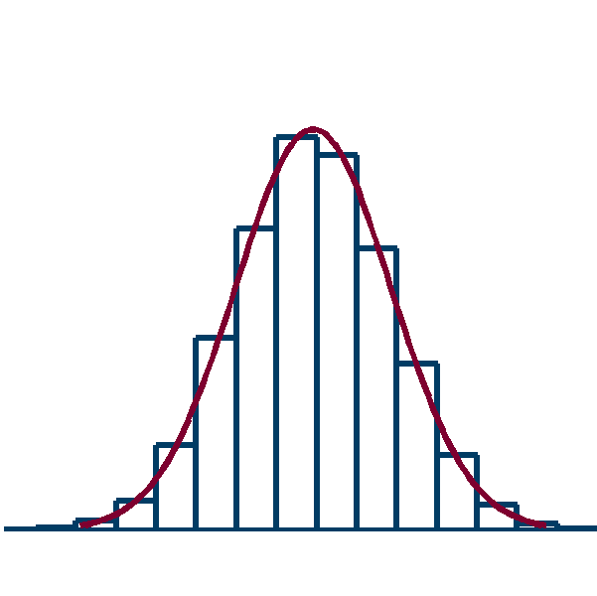
Noise models
Noise model for each coil
Scanner
K-space
X-space
(complex)
F⁻¹
Complex Gaussian
σ²_{Κ}
Complex Gaussian
σ²_{n}=σ²_{Κ} /|Ω|
16

Slide 17
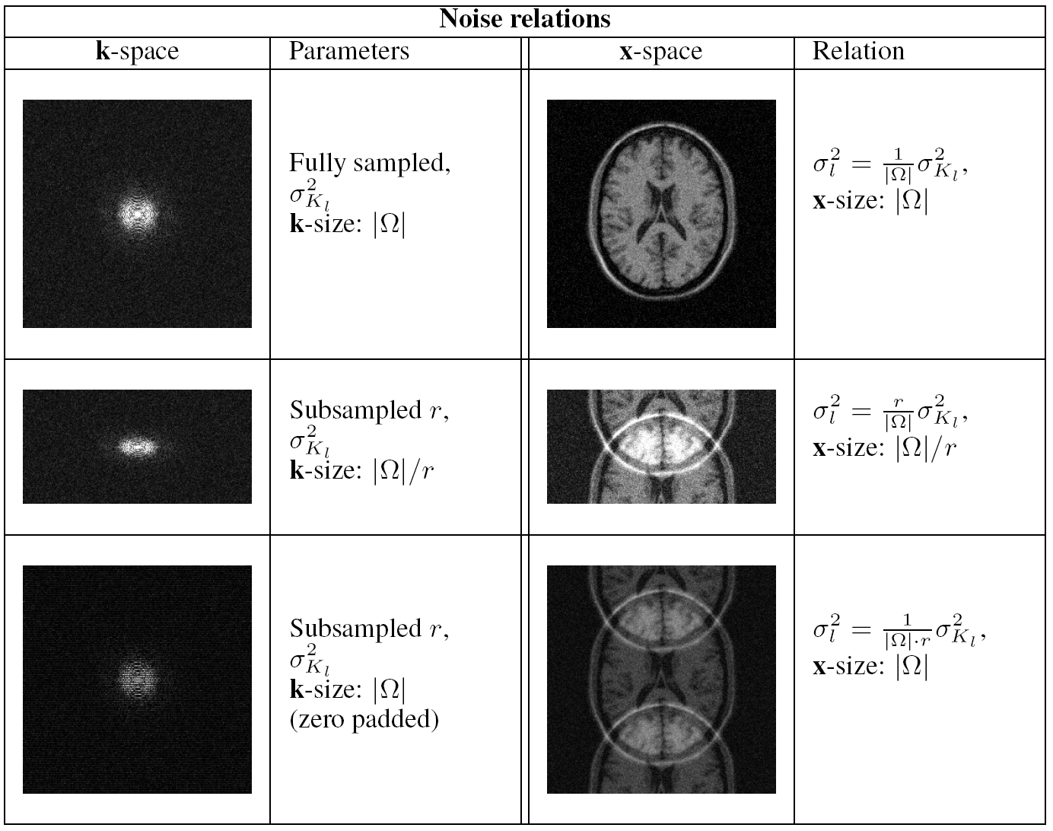
Noise models
17

Slide 18
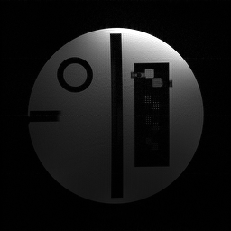
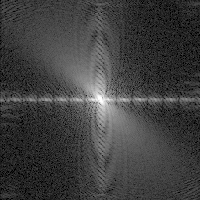
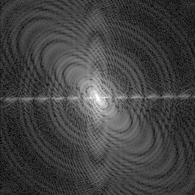
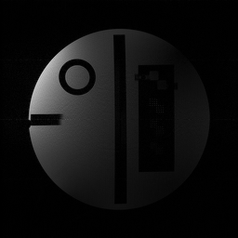
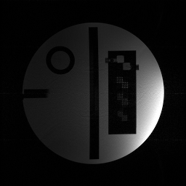
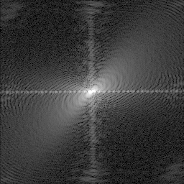
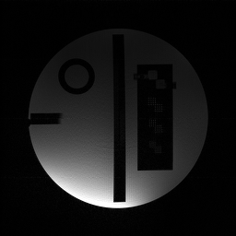
σ²₁
ρ₁₄
ρ₁₂
ρ₁₄
ρ₁₂
σ²_{Κ1}
F⁻¹
σ²_{Κ4}
σ²_{Κ3}
σ²_{Κ2}
σ²₄
σ²₂
ρ₃₄
ρ₂₃
ρ₃₄
ρ₂₃
Complex Gaussian
σ²_{Κi}
σ²₃
Complex Gaussian
σ²_{i}=σ²_{Κi} /|Ω|
18

Slide 19
Noise models
Noise model for each coil
19

Slide 20
2- Single coil: the Rician Distribution

Slide 21
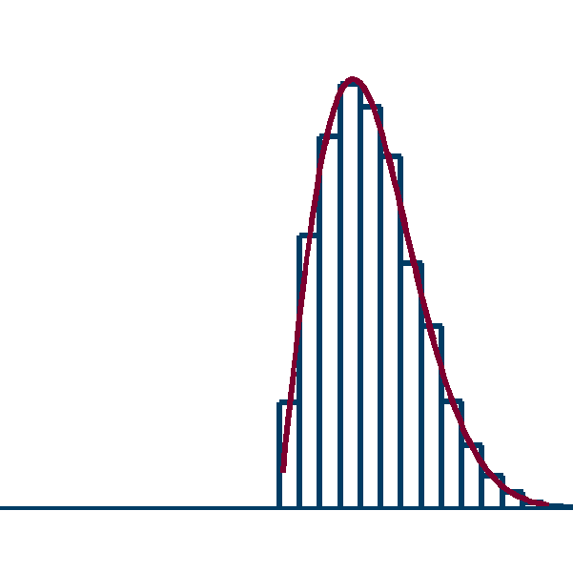
Noise models
Single coil: the Rician distribution
K-space
X-space (complex)
Magnitude
F⁻¹
| . |
Complex Gaussian
σ²_{Κ}
Complex Gaussian
σ²_{n}=σ²_{Κ} /|Ω|
Rician
σ²_{n}
21

Slide 22
Noise models
22

Slide 23
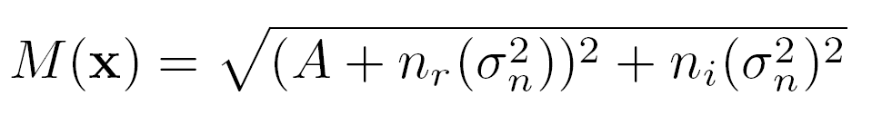
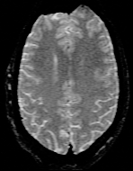
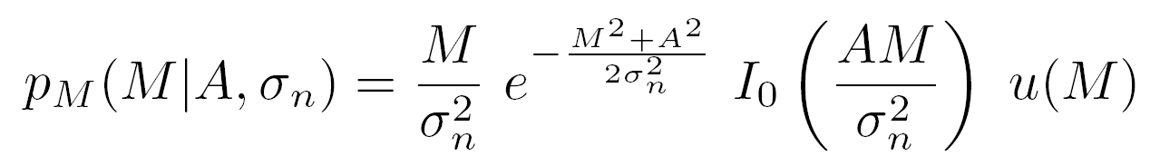
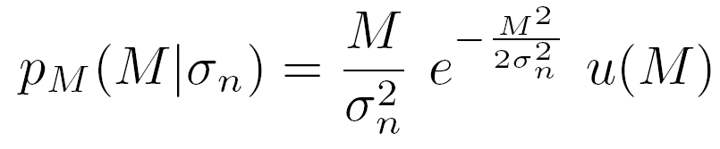
Noise models
Rician Model
Complex
Magnitude
Rician
Rayleigh
23

Slide 24
Noise models
Gaussian
Rician
σ_{n}
Meaning of σ_{n}?
SNR=A / σ_{n}
24

Slide 25
3- Multiple coil (non acceletared)

Slide 26
Noise models
Multiple coil acquisition
ρ₁₄
ρ₁₂
Particular case:
σ²₁
σ²_{i=} σ²_{j =} σ²_{n}
ρ_{ij} = 0
Σ = σ²_{n} ·I
σ²₄
σ²₂
ρ₃₄
ρ₂₃
Complex Gaussian
σ²_{i}=σ²_{Κi} /|Ω|
σ²₃
26

Slide 27
Noise models
27

Slide 28
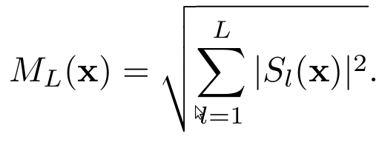
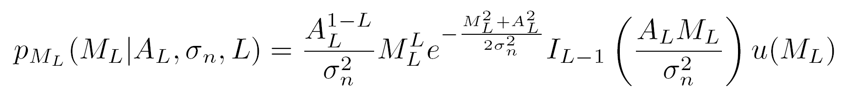
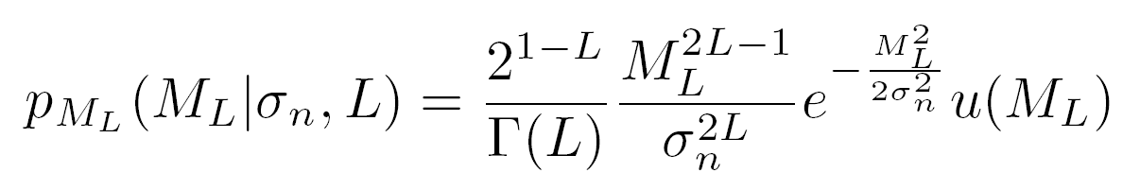
Noise models
Non-central chi model
Non Central Chi
Central Chi
28

Slide 29
Noise models
Basic models:
Rician: relation between σ²_{n} and variance of noise in Gaussian complex data.
Nc-chi: also relation between σ²_{n} and Gaussian Variance.
Nc-chi: many times, interesting parameter σ²_{n}·L
  E{M(x)²}=A(x)²+2L·σ²_{n}
  SNR=A(x)/L^{1/2}·σ_{n}
  Usually: equivalence between L·σ²_{n} (nc-chi) and σ²_{n} (Rician).
29

Slide 30
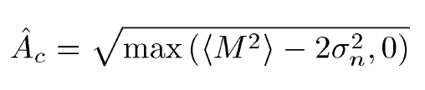
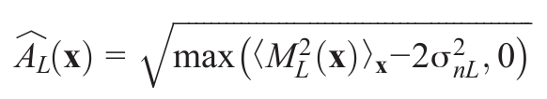
Noise models
Example: Conventional approach
Rician
Noncentral-chi
30

Slide 31

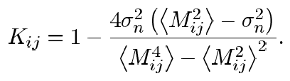

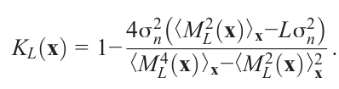
Noise models
Example: LMMSE filter
Rician
Noncentral-chi
31

Slide 32
Noise models
Limitation of the nc-chi model:
Only valid if:
Same variance of noise in each coil
No correlation between coils
No acceleration
Reconstruction done with sum of squares
Real acquisitions.
Correlated, different variances
Accelerated
Reconstructed with different methods
32

Slide 33
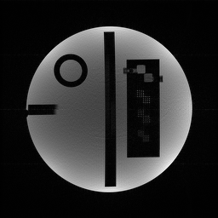
Noise models
Effect of Correlations
ρ₁₄
ρ₁₂
σ²₁
Sum of Squares
σ²₃
σ²₄
σ²₂
ρ₃₄
ρ₂₃
Nc-chi no longer valid!!!
33

Slide 34
Noise models
34

Slide 35
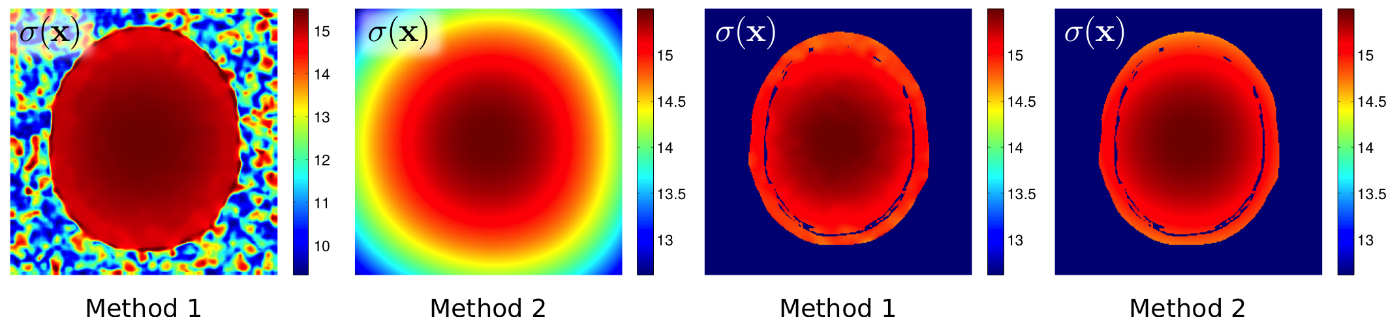
Noise models
35

Slide 36
4- Simplified models

Slide 37
Noise models
Simplified models:
Rician and nc-chi models for high SNR (usually SNR>3) can be assumed Gaussian
Rician:
M(x)≈A(x)+n_{r}(σ_{n}²)
Nc-chi:
M_{L}(x) ≈A_{T}(x)+n_{r}(σ_{T}²)
If correlations considered: σ_{T} = σ_{T}(x)
37

Slide 38
5- Parallel Imaging

Slide 39
Noise models
pMRI
39

Slide 40
Noise models
SENSE
40

Slide 41
Noise models
41

Slide 42
Noise models
42

Slide 43
Noise models
GRAPPA
43

Slide 44
Noise models
44

Slide 45
Noise models
45

Slide 46
Noise models
46

Slide 47
Noise models
Final remarks
Statistical modeling: useful!
Stationary Rician model: not the only model
Stationarity: important issue
(Unknown) processes in the scanner change the model
Consider simplifications: Gaussian model
47

Slide 48
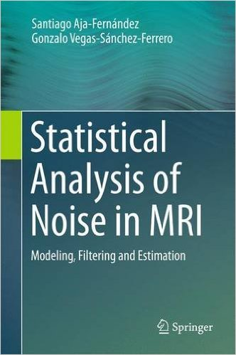
Statistical Analysis
of Noise in MRI
Springer

Slide 49

Questions?

Slide 50
Universidad de Valladolid
E.T.S. Ingenieros de Telecomunicación
Statistical analysis of noise in MRI:
Noise modeling
Santiago Aja-Fernández,
Laboratorio de Procesado de Imagen. Universidad de Valladolid (Spain)
www.lpi.tel.uva.es sanaja@tel.uva.es
OCTOBER 2016

