Slide 1


What to measure
when measuring noise in MRI
Santiago Aja-Fernández
sanaja@tel.uva.es
Antwerpen 2013

Slide 2
Motivation:
Many papers and methods to estimate noise out of MRI data.
Noise estimation vs. SNR estimation
In single coil systems, variance of noise is a “good” measure.
Complex systems: what are we really measuring? Is the variance of noise still valid?

Slide 3
Outline
Noise in MR acquistions
Basic Models
      Rician
      Non-central chi
More Complex Models
      Correlated multiple coils
      Parallel MRI: SENSE and GRAPPA
The nc-chi example
      Non-stationary noise
      Effective values
  Other models
Conclusions

Slide 4
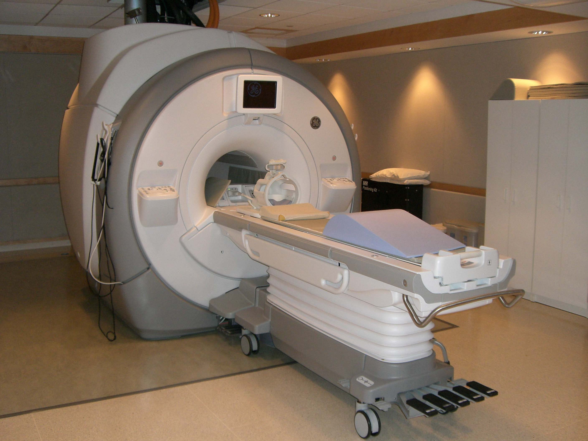

Slide 5


Slide 6
1- Noise in MRI

Slide 7
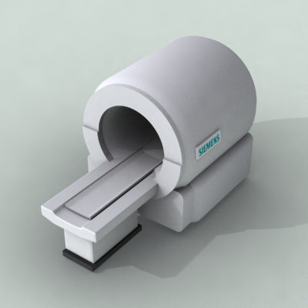
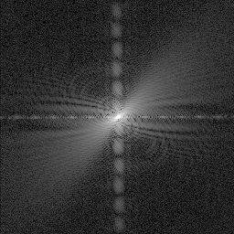
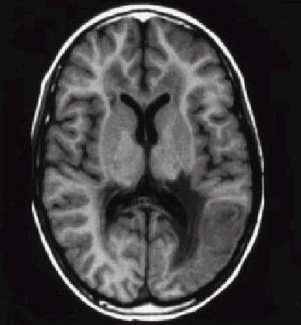
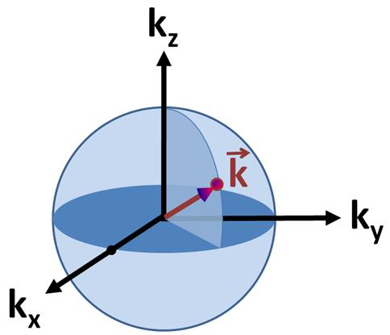
Signal acquisition (Single coil)
X-space
(complex)
Scanner
K-space
magnitude
F⁻¹
| . |

Slide 8
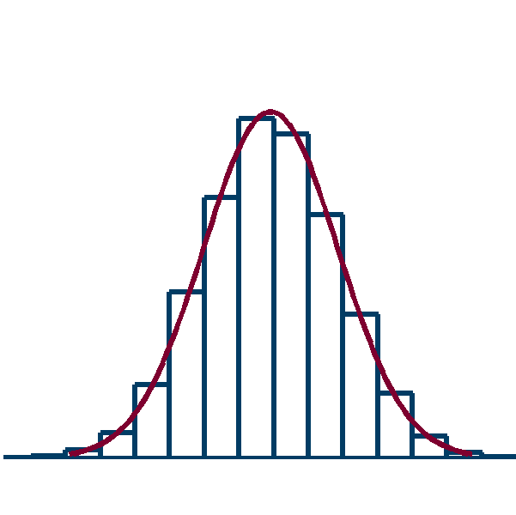
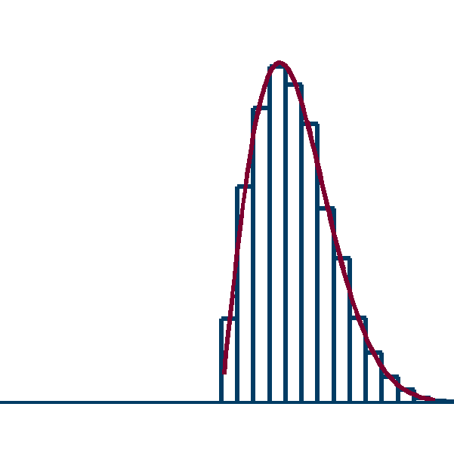
Acquisition Noise (single coil)
X-space
(complex)
K-space
magnitude
F⁻¹
| . |
Complex Gaussian
σ²_{Κ}
Complex Gaussian
σ²_{n}=σ²_{Κ} /|Ω|
Rician
σ²_{n}

Slide 9
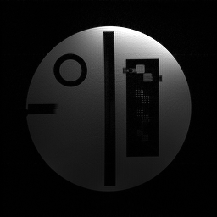
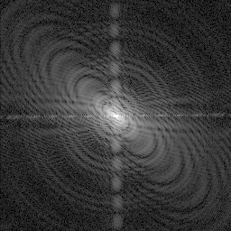

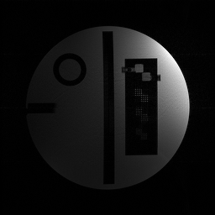
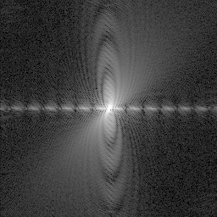
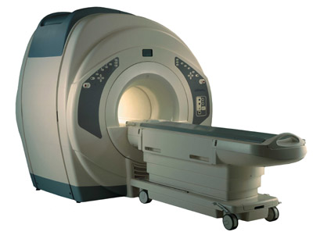
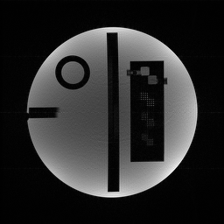
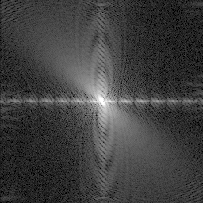
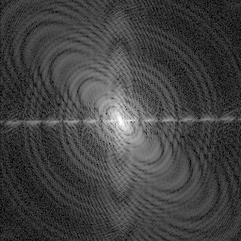
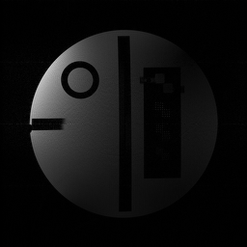
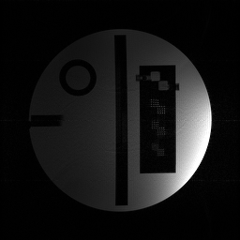
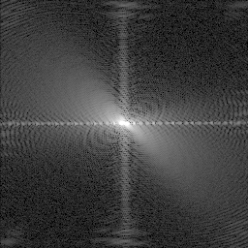
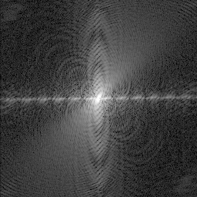
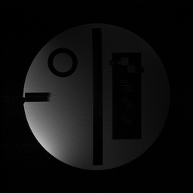
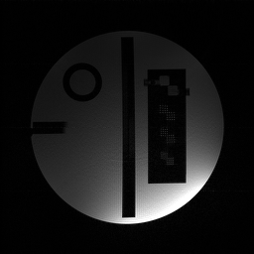
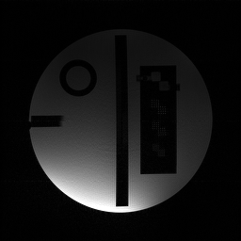
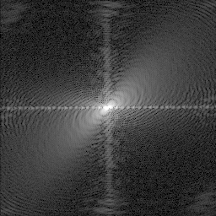
Signal acquisition (Multiple coil)
F⁻¹
9

Slide 10
Acquisition noise (Multiple coil)
ρ₁₄
ρ₁₂
ρ₁₄
ρ₁₂
σ²_{Κ1}
σ²₁
F⁻¹
σ²_{Κ4}
σ²_{Κ2}
σ²₄
σ²₂
ρ₃₄
ρ₂₃
ρ₃₄
ρ₂₃
σ²_{Κ3}
σ²₃
Complex Gaussian
σ²_{Κi}
Complex Gaussian
σ²_{i}=σ²_{Κi} /|Ω|
10

Slide 11
Acquisition noise:
Noise in receiving coils is complex Gaussian (assuming no post-processing)
Noise in x-space related to noise in k-space
Final distribution will depend on the reconstruction

Slide 12
2- Basic Noise Models

Slide 13
Rician Model
X-space
(complex)
K-space
magnitude
F⁻¹
| . |
Complex Gaussian
σ²_{Κ}
Complex Gaussian
σ²_{n}=σ²_{Κ} /|Ω|
Rician
σ²_{n}

Slide 14
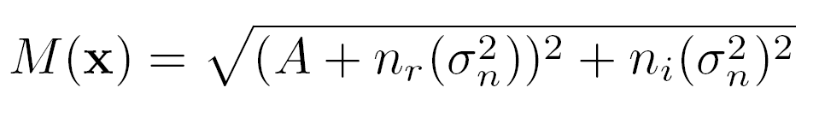
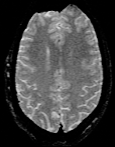
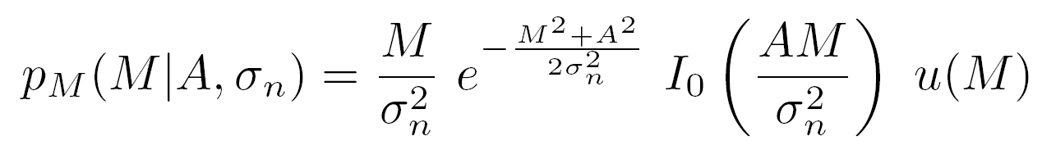
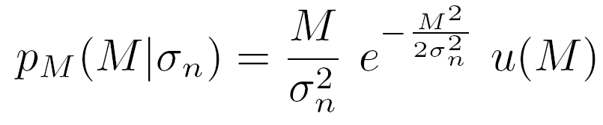
Rician Model
Complex
Magnitude
Rician
Rayleigh
14

Slide 15
Gaussian
Rician
σ_{n}
Meaning of σ_{n}?
SNR=A / σ_{n}

Slide 16
Non-central chi model
ρ₁₄
ρ₁₂
Particular case:
σ²₁
σ²_{i=} σ²_{j =} σ²_{n}
ρ_{ij}=0
σ²₄
σ²₂
ρ₃₄
ρ₂₃
σ²₃
Complex Gaussian
σ²_{i}=σ²_{Κi} /|Ω|

Slide 17
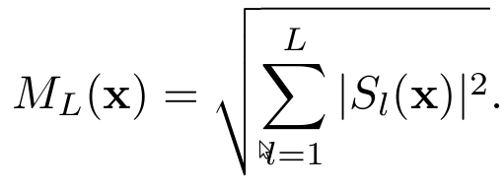
Non-central chi model
σ²_{n}
Sum of Squares
σ²_{n}
σ²_{n}
σ²_{n}
Complex Gaussian
σ²_{n}|
Non central chi
L, σ²_{n}|

Slide 18
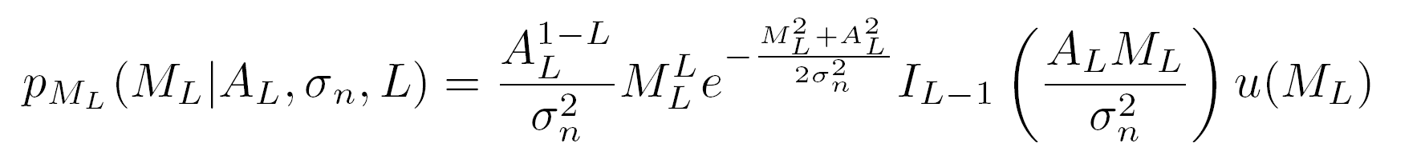
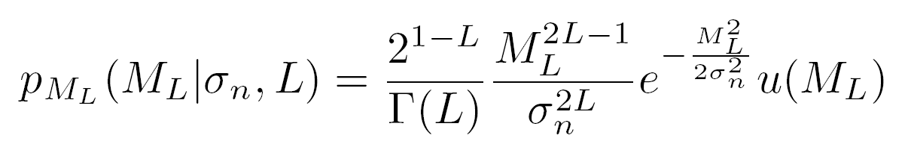
Non-central chi model
Non Central Chi
Central Chi

Slide 19
Basic models:
Rician: relation between σ²_{n} and variance of noise in Gaussian complex data.
Nc-chi: also relation between σ²_{n} and Gaussian Variance.
Nc-chi: many times, interesting parameter σ²_{n}·L
  E{M(x)²}=A(x)²+2L·σ²_{n}
  SNR=A(x)/L^{1/2}·σ_{n}
  Usually: equivalence between L·σ²_{n} (nc-chi) and σ²_{n} (Rician).

Slide 20
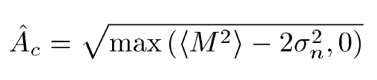
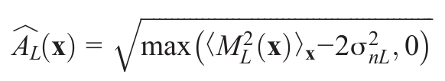
Example: Conventional approach
Rician
Noncentral-chi

Slide 21

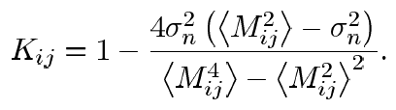

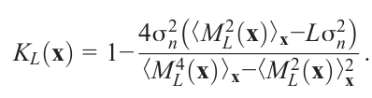
Example: LMMSE filter
Rician
Noncentral-chi

Slide 22
3- More Complex Models

Slide 23
Limitation of the nc-model:
Only valid if:
Same variance of noise in each coil
No correlation between coils
No acceleration
Reconstruction done with sum of squares
Real acquisitions.
Correlated, different variances
Accelerated
Reconstructed with different methods

Slide 24
A- Effect of Correlations
ρ₁₄
ρ₁₂
σ²₁
Sum of Squares
σ²₄
σ²₂
ρ₃₄
ρ₂₃
Nc-chi no longer valid!!!
σ²₃

Slide 25
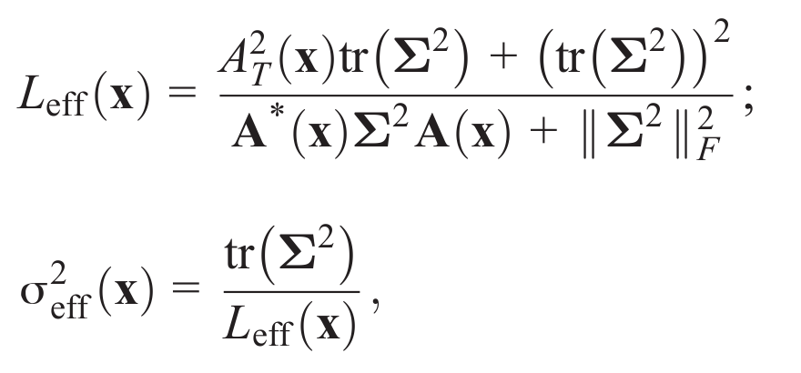
Nc-chi approximation if effective parameters are used
Relative errors in the PDF for central-chi approximation as a function of the correlation coefficient. A) Using effective parameters. B) Using the original parameters.

Slide 26
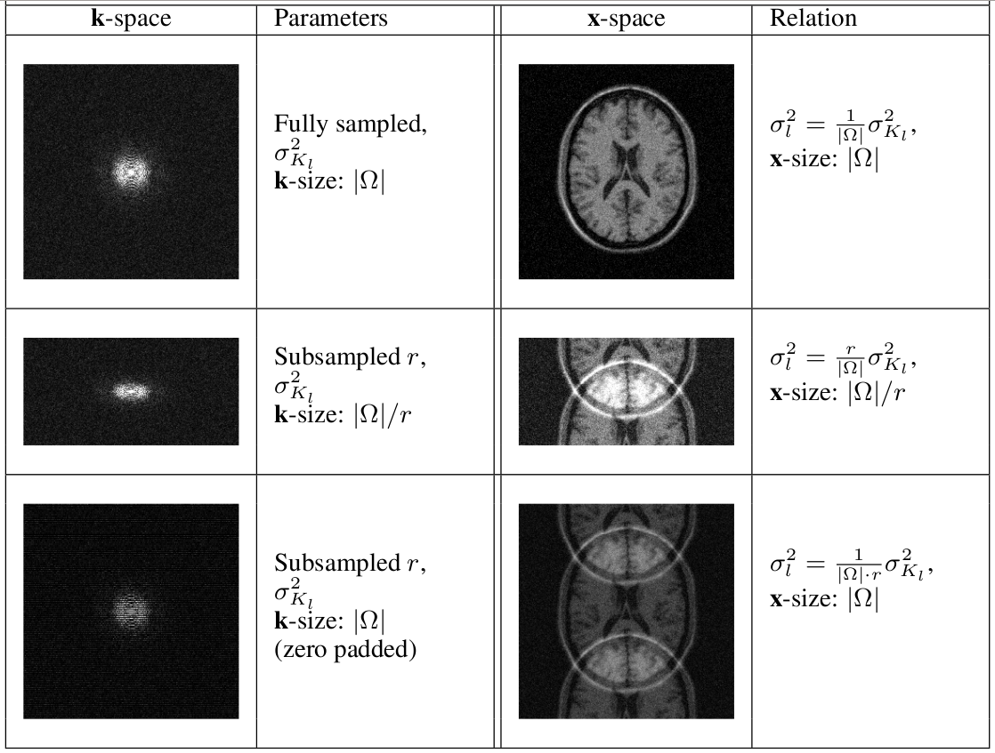
B- Sampling of the k-space:

Slide 27
In real acquisitions:
Different variances and correlations → effective values and approximated PDF.
Subsampling → modification of σ²_{i} in x-space
Reconstruction method → output may be Rician or an approximation of nc-chi
The variance of noise (σ²_{i}) becomes x-dependant → σ²_{i}(x)

Slide 28
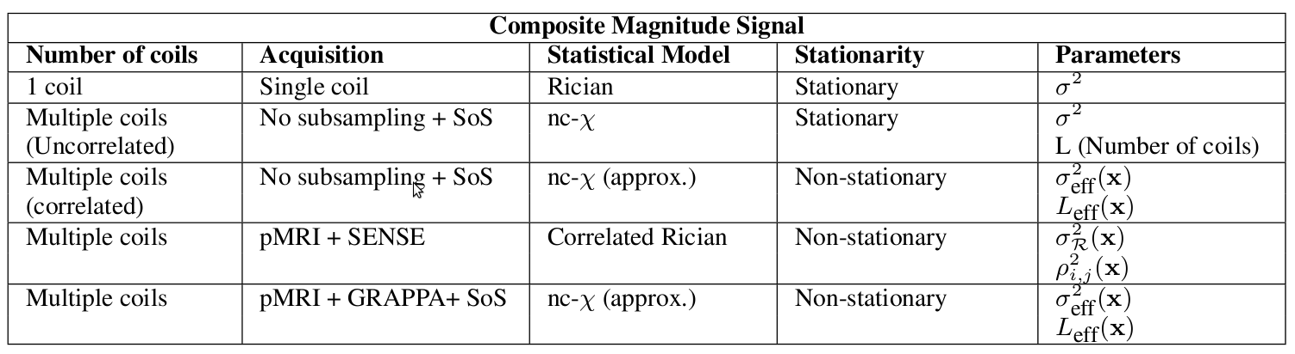
Survey of statistical models for MRI

Slide 29
4- Example:
the non stationary nc-chi
approximation

Slide 30
Nc-chi approximation
ρ₁₄
ρ₁₂
σ²₁
Sum of Squares
σ²₄
σ²₂
ρ₃₄
ρ₂₃
σ²₃
Nc-chi approximation if effective parameters are used

Slide 31
Effective number of coils as a function of the coefficient of correlation.
A) Absolute value. B) Relative Value.

Slide 32
σ_{eff}(x)
L_{eff}(x)

Slide 33
Params. σ_{eff}(x) and L_{eff}(x) both depend on x.
Good news:
L_{eff}(x)· σ²_{eff}(x)= tr(Σ)=σ²₁+…+ σ²_{L}=L·< σ²_{i} >
The product is a constant:
L_{eff}(x)· σ²_{eff}(x)=L·σ²_{n}

Slide 34
Implications:
Equivalence between effective and real parameters
Product: easy to estimate
L_{eff}(x)· σ²_{eff}(x)= L·σ²_{n}=mode{ E{M_{L}²(x)}_{x} } / 2
In some problems: only product needed:
I²(x)= E{M_{L}²(x)}_{x} - 2L·σ²_{n}
NOTE: If effective values are used for σ²_{eff}(x), also for L_{eff}(x)·
σ²_{eff}(x)·L → Wrong!!!

Slide 35
Implications:
My point of view: σ²_{eff}(x) and L_{eff}(x) should be seen as a single parameter:
σ²_{L} = L_{eff}(x) · σ²_{eff}(x)
and therefore
σ²_{eff}(x) = σ²_{L} / L_{eff}(x)
Some applications do need σ²_{eff}(x)

Slide 36
X-dependant noise:
Param. σ²_{eff}(x) now depends on position.
The dependence can be bounded.
SNR → 0
σ²_{B}= σ²_{n}(1+<ρ²>(L-1))
SNR → ∞
σ²_{S}= σ²_{n}(1+<ρ>(L-1))
Total:
σ²_{eff}(x)=(1-φ(x)) σ²_{S} + φ(x) σ²_{B}
with
φ(x)=(SNR²(x)+1)⁻¹

Slide 37
Where is noise estimated?
What to estimate: σ²_{eff}(x), σ²_{n},σ²_{B,} σ²_{S}…
σ²_{B}
σ²_{S}

Slide 38
Implications:
Estimation over the background → underestimation of noise.
Use of a single value of σ_{n} → error is most areas.
Noise is higher in the high SNR.
Main source of non-stationarity: correlation between coils.
High correlation: lower effective coils and higher noise.
Possible source of error: σ²_{eff}(x)·L

Slide 39
5- Other models

Slide 40
SENSE: (non stationary Rician)
σ²_{R}(x) x-dependant noise
σ²_{n} = σ²_{K} (r / |Ω|)

Slide 41
σ_{eff}(x)
L_{eff}(x)
(σ²_{eff}(x) L_{eff}(x) )^{1/2}
GRAPPA: nc-chi approx.
σ²_{n} = σ²_{K} / (r |Ω|)
Product σ²_{eff}(x)·L_{eff}(x) is not a constant

Slide 42
6- Conclusions

Slide 43
Conclusions:
Be sure what you need in your application.
Follow the whole reconstruction pipeline to be sure which is your “original” noise.
Useful: simplified models to make process easier.
Be sure how noise affects the different slides.

Slide 44

Questions?

Slide 45
What to measure
when measuring noise in MRI
Santiago Aja-Fernández
sanaja@tel.uva.es
Antwerpen 2013

